Slide 1
(Very) Brief Intro to GIT

Slide 2
Resources
https://happygitwithr.com/
Really focus on the “Installation” steps
Register Github Account
Install/Upgrade R and Rstudio
Install Git
Introduce yourself to Git
Install a Git Client (optional)
https://opensource.com/article/18/1/step-step-guide-git
https://towardsdatascience.com/getting-started-with-git-and-github-6fcd0f2d4ac6

Slide 3
Cloning the repo for class
Really just to “pull” the latest materials/slides
Easiest: use built-in Rstudio functionality
Step 1: File → New Project

Slide 4
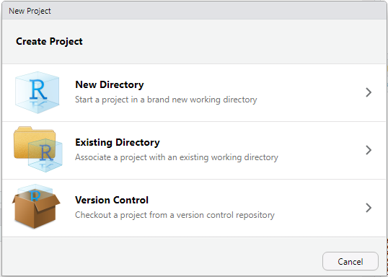
Step 2

Slide 5
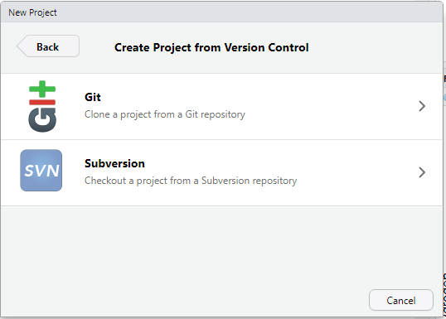
Step 3

Slide 6
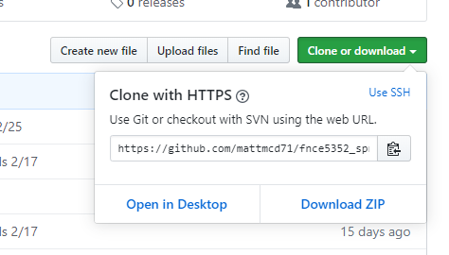
Step 4
Get the HTTPS Link from Github
(its: https://github.com/mattmcd71/fnce5352_spring2020.git)

Slide 7
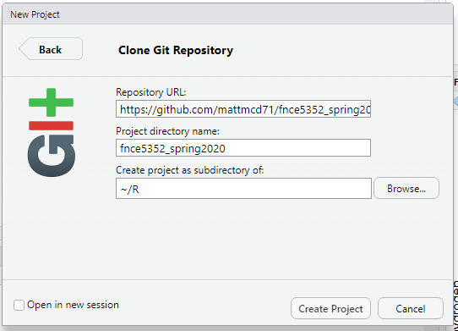
Step 5
Note: the default is to create local workspace as a subdirectory of R’s “home” directory. In my case, it’s in my “My Documents” folder.

Slide 8
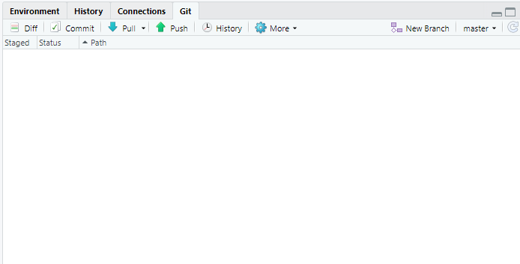
Step 6
Get updates by clicking the “Pull” button in the Rstudio GIT pane

Slide 9
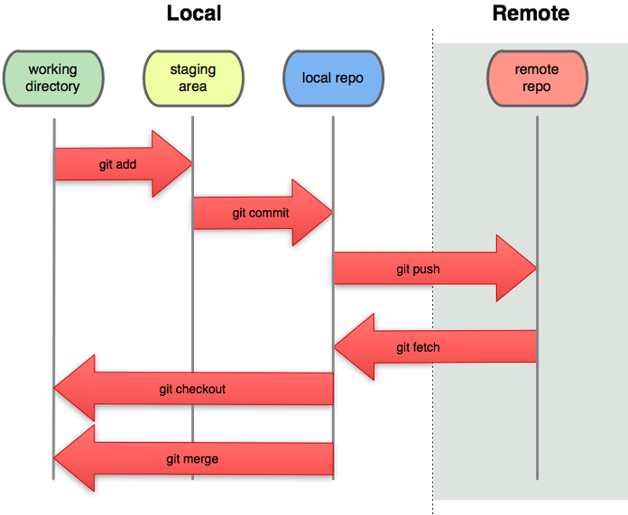
Local vs Remote

